Slide 1

Smart doc: AI Powered Medical Consultant with a Human Intellect to Support and Enhance People’s Lives in Emergencies
M. Aishwarya
RA1811003040117
4th year
CSE ‘D’

Slide 2
Abstract
Tech-based self-service channels and digital health interventions have the potential to support the patients in their everyday life and health professionals likewise. With the rise in artificial intelligence and innovation in digital technologies have paved the way for the medical systems to expand to meet the expectations of the people who need health care support especially during these kinds of unprecedented circumstances such as the hay fever, flu and other viral infections.
Although there are scalable self-service channels such as Alexa, Google Assistant, Siri, yet they cannot be applied in medical care settings due to their lack of domain knowledge. Hence this project presents a healthcare chatbot called ‘Smart Doc’ created using Artificial Intelligence that can have a significant impact on the lives of the people. This chatbot provides us with a human-system interaction with a user-friendly interface and it aims to solve the specific prerequisites of a person who need healthcare suggestions before visiting the hospital. The chatbot system works on the inputs provided by the user (patient) and answers it accordingly.
The functionalities of Smart Doc include primary healthcare services where a normal person with a mobile can be able to have an interaction regarding the services. The chatbot enables the person to identify themselves by providing their age and contact number and then allows them to specify their symptoms. It also helps to schedule an appointment with the concerned doctor in a nearby hospital facility or to have an online discussion with the doctor regarding the treatment. The chatbot will also be able to manage the appointments for specific dental and optical services and to give suggestions regarding precautionary measures. This will reduce the healthcare costs and improve accessibility to medical knowledge even for people living in rural areas while enhancing their lives at the same time.

Slide 3
Proposed and Existing System
Many of the existing systems have live chats through texts and some limitation such as there is no instant response given to the patients they have to wait for experts acknowledgement for a long time. Some of the processes may charge amount to live chat or telephony communication.
The Proposed System consists of a user friendly chat interface through which a user can communicate with the system. It focuses on a healthcare chatbot which analyses the user’s symptoms through a conversation with the user and map these symptoms to the available dataset. The Smart Doc can converse with the user via text or speech. Natural Language Processing (NLP) is applied to the user input to determine the symptoms. The symptoms are then passed to a Machine Learning (ML) algorithm that has been trained to diagnose diseases based on symptoms. The chatbot can make a predictive diagnosis. This can assist in providing the initial response as well as guide the individual to a specialized healthcare professional.

Slide 4
Modules
Input
Input from user
Analyze and process
Analyze and process user’s input
Identify
Identify the symptom
Compose
Compose Reply
Schedule and Manage
Schedule Appointments

Slide 5
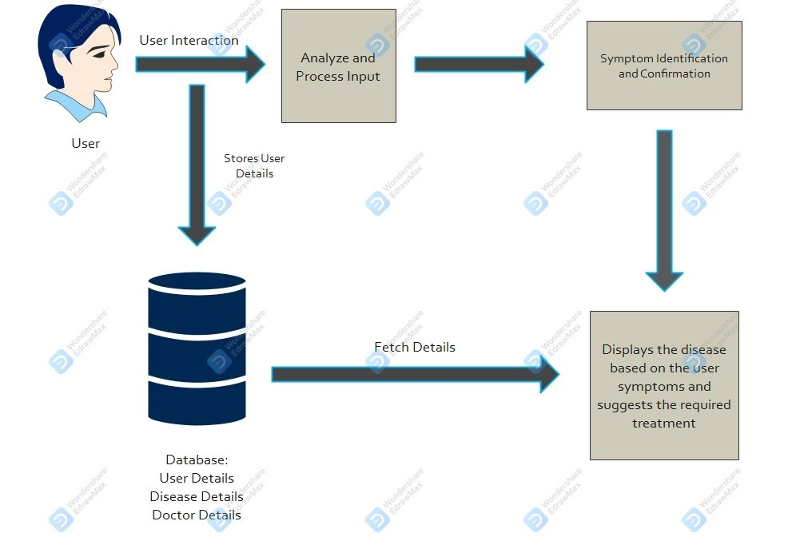
Architecture Diagram

Slide 6
Literature Survey
Divya Madhu [1] proposed an idea in which the AI can predict the diseases based on the symptoms and give the list of available treatments If a person‘s body is analyzed periodically, it is possible to predict any possible problem even before they start to cause any damage to the body. Some Challenges are research and implementation costs, and government regulations for the successful implementation of personalized medicine, they are not mentioned in the paper.
Hameedullah Kazi [2] describes the development of a chatbot for medical students, that is based on the open source AIML based Chatter bean. The AIML based chatbot is customized to convert natural language queries into relevant SQL queries. A total of 97 question samples were collected and then those questions were divided into categories depending on the type of question. According to the number of questions in each category the resultant categories were ranked. Questions were based on queries, where 47% are of posed questions
Saurav Kumar Mishra [3] says that the chatbot will act as a virtual doctor and makes possible for the patient to interact with virtual doctor. Natural language processing and pattern matching algorithm for the development of this chatbot. It is developed using the python Language. Based on the survey given it is found that the no of correct answer given by the chatbot is 80% and incorrect/ambiguous answer given is 20%.From this survey of chatbot and analysis of result suggested that this software can be used for teaching and as a virtual doctor for awareness and primary care.

Slide 7
Advantages
Enhance Patient Access
Saves Time and Money
Offers Quick Data

Slide 8
Tools Used
Python
HTML
CSS
JavaScript
Flask
SQL

Slide 9
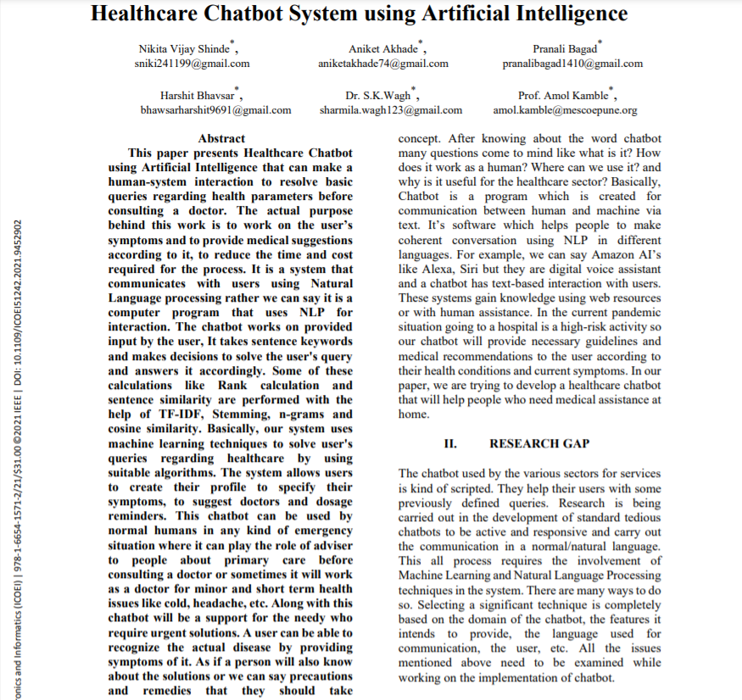
Base Paper Title
Healthcare Chatbot System using Artificial Intelligence

Slide 10
Thank you

